Slide 1
Class Kick

Slide 2
Find the Classkick App

Slide 3
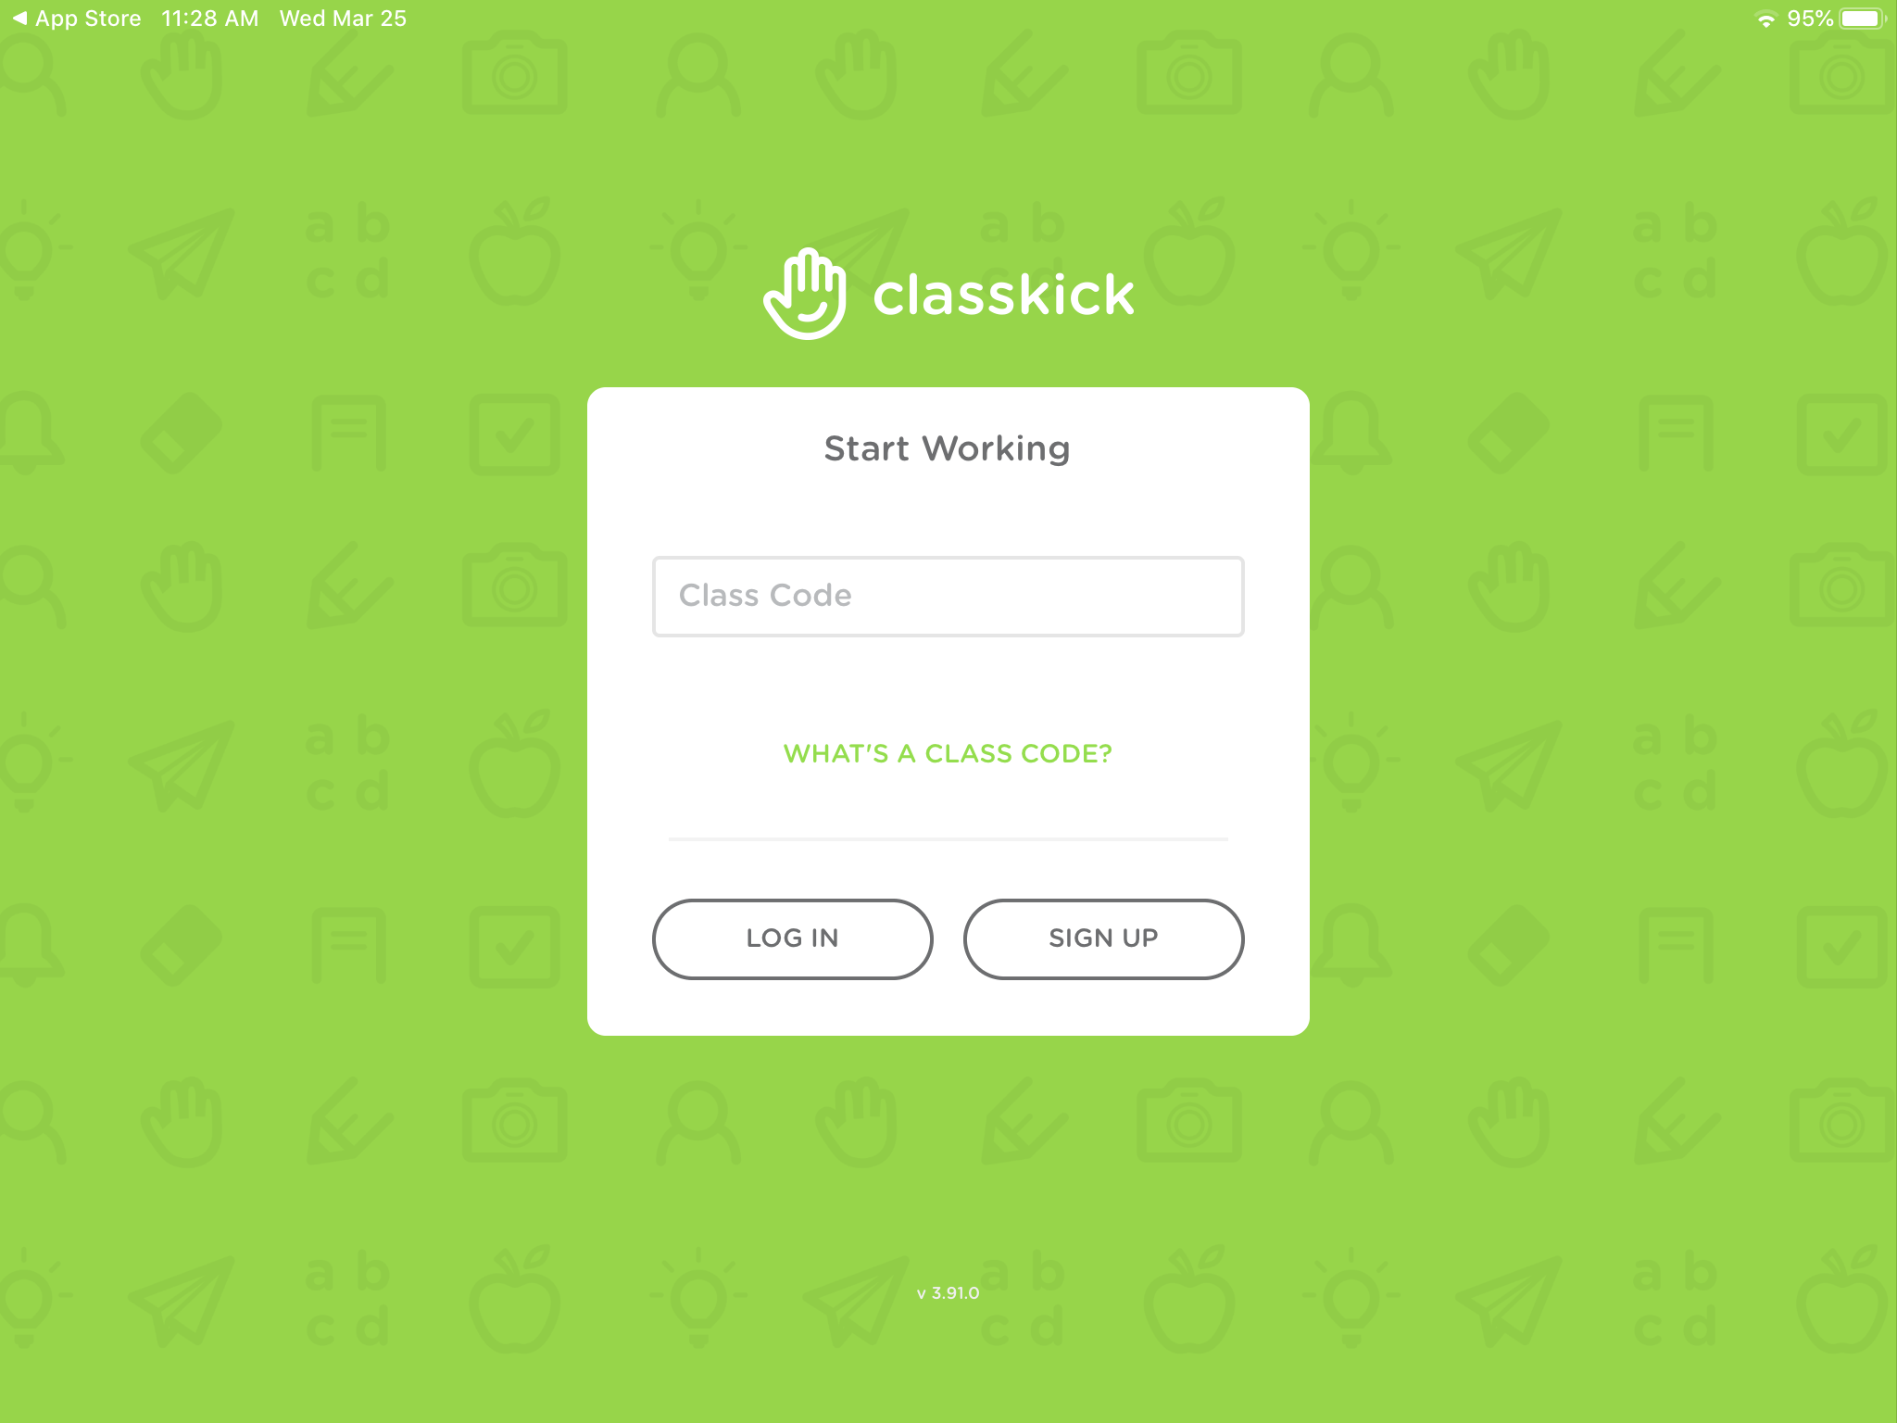
Click Log in

Slide 4
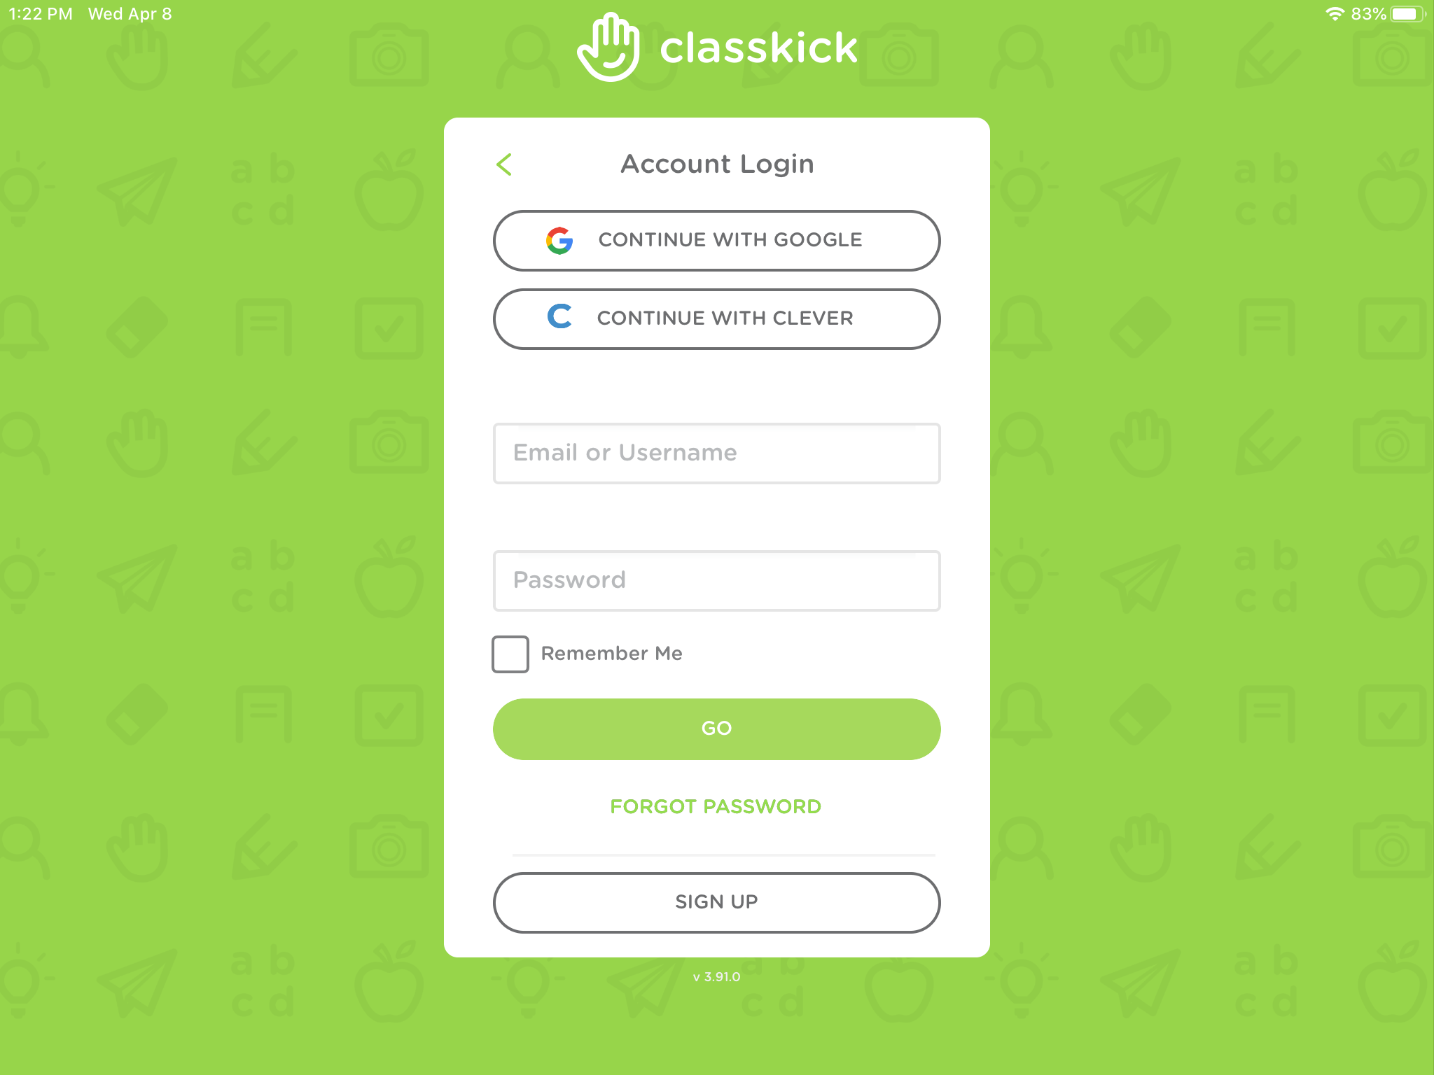
Type student’s username and password
Student’s username@tulpehocken.org
Student’s lunch pin number
Press go after you typed in the username, password and checked the box.
Click in this box so you don’t have to type username every time

Slide 5
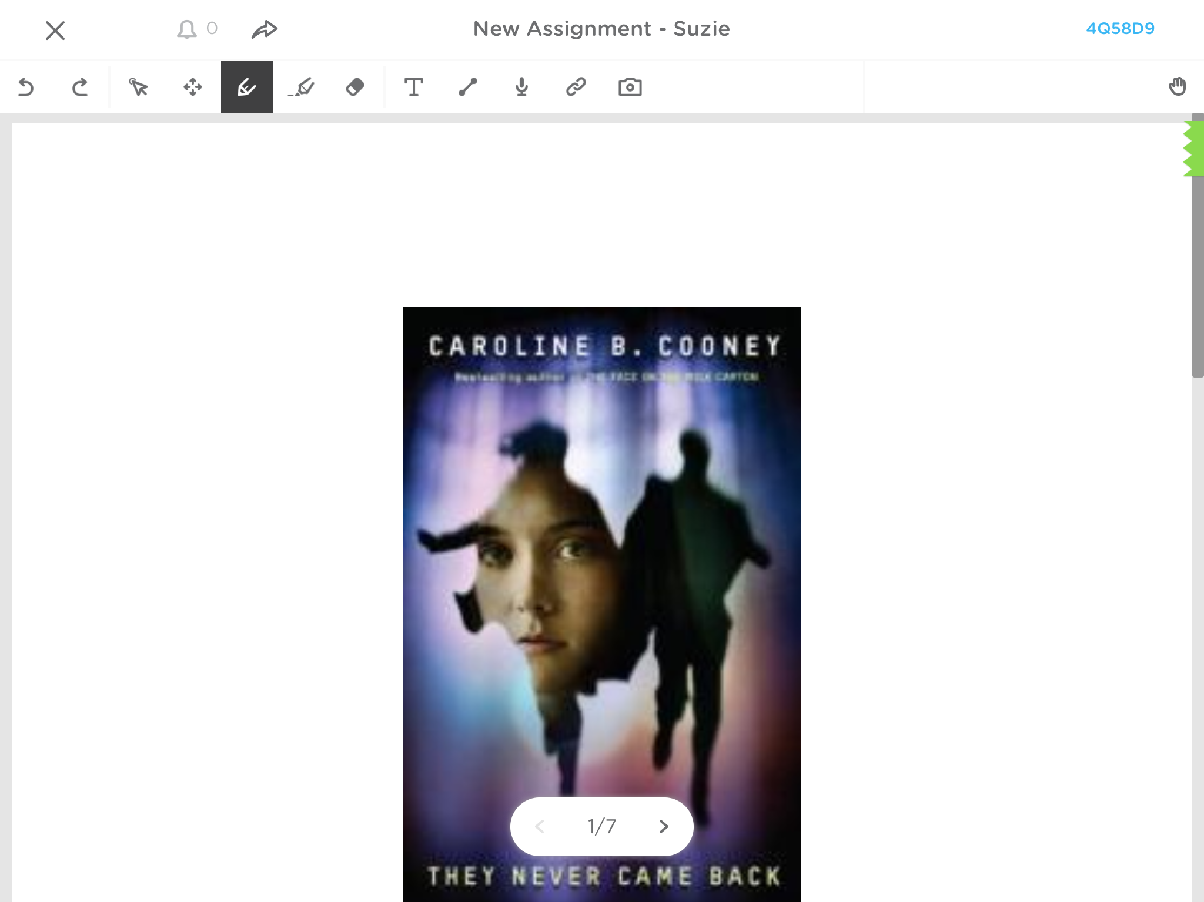
Tools for completing assignments. Explained on next two slides.
Advance to next page in assignment

Slide 6
Tools
Signs out
Highlight tool (tap twice to change color or size)
Select/move tool
Add text
Scroll tool
Eraser (tap twice to clear all
Pen tool (tap twice to change color or size)

Slide 7
More Tools
Turn in assignment or notify teacher you need help
Line Tool
Add Link
Record Voice
Add photo (from camera or photos

